Slide 1
Chapter 13
Application Analysis

Slide 2
Topic Covered
Application Interaction Model
Application Class Model
Overview of class Design

Slide 3
Application Interaction Model
Most domain model focus on building a model of intrinsic concepts.
While Application model focus on the details of the application and consider interaction.
You can construct application interaction model with following steps:
Determine the system boundary
Find actor
Find use cases

Slide 4
Application Interaction Model
Find initial and final events
Prepare normal scenarios
Add variation and exception scenarios
Find external events.
Prepare activity diagram for complex use cases.
Organize actors and use cases
Check against the domain class model.

Slide 5
Application Interaction Model
Determine the system boundary
Must know scope of an application to specify functionality.
It means, you must decide what system includes and what it omits.
If boundary is correct, you can treat system as box where internal details are hidden and changeable.
At this state, determine purpose of the system.

Slide 6
Application Interaction Model
Don’t consider humans as part of system,
Ex. From problem statement (Chap 11), mentioned “ design system for human cashiers and Automatic Teller machine (ATM)..”
So here there will two different system is going to be design.
Human Cashier (Will be used at Bank)
ATM ( At ATM location).
Note: Will focus on ATM behavior only.

Slide 7
Application Interaction Model
Finding Actors
Identify the external object that interact directly with the system called Actors
Actors includes
Humans, external devices and other software systems.
In finding actors, we are not searching for individual but for standard behavior.
Each actor should be idealized.

Slide 8
Application Interaction Model
It is possible for different kinds of external to play the same actor.
Ex. ATM application, the actors are Customer, Bank and Consortium.

Slide 9
Application Interaction Model
Finding Use Cases
For each actor, list the functionality different ways in which the actor uses the system called Use Cases.
Use cases partition the functionality of a system into a small number of discrete units.
Each use cases should represent a kind of service that system provides – something that provides value to the actor.

Slide 10
Application Interaction Model
Keep similar level of detail for use cases
“Apply for loan”
It should not be “Withdraw cash from saving account using ATM” . Restate with “Make Withdrawal”
Now draw preliminary use case diagram.
Show actors and use cases, connect actors to use cases.
Usually, you can associate a use case with the actor that initiates it.

Slide 11
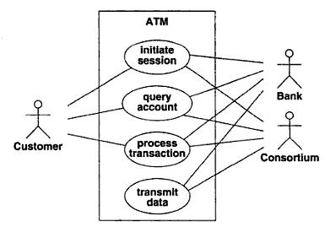
Application Interaction Model
You should also write a one or more sentence for each use case.

Slide 12
Application Interaction Model
Initiate session: ATM establish the identity of the user and make a list of accounts and actions.
Query Account: System provides general data for an account, such as current balance, date of last transaction etc.
Process Transaction: transaction like deposit, withdraw and transfer.
Transmit Data: ATM uses the consortium’s facilities to communicate with the appropriate bank computers.

Slide 13
Application Interaction Model
Finding Initial and Final Events
Use case diagram does not show behavior clearly.
To Understand behavior, you must understand the execution sequences of each use cases.
Determine which actor initiate the use case.
In may case, initial event is request for services that use case provides.

Slide 14
Application Interaction Model
In many cases, initial event is occurrence that triggers a chain of activity.
Similar, determine final event(s).
For ex. For “apply of loan” would continue until
Application submit
Loan grant or reject
Loan is delivered.
Paid off and Closed.
User must define the scope for termination.

Slide 15
Application Interaction Model
For ATM Example:
Initiate session:
Initial Event is customer’s insertion of a cash card.
Two Final Event: system keeps cash card and system returns the cash card.
Query Account:
Initial Event is customer’s request for account data.
Final event is system retrieve data for customer.

Slide 16
Application Interaction Model
Process Transaction:
Initial event is customer’s initiation of transaction.
Two final event : committing or aborting it.
Transmit Data:
Initial event:
customer’s request for account data.
Recovery from network, power or kind of failure.
Final event: successful transmission of data.

Slide 17
Application Interaction Model
Preparing Normal Scenarios
For each use case, prepare one or more story base scenarios.
Scenario illustrate the major interactions, external display and information exchange.
Scenario is a sequence of events among a set of interacting objects.
Think in terms of sample interactions.
Sometime problem statement describes full interaction sequences, but most of time you will have invent.

Slide 18
Application Interaction Model
So prepare scenarios for “normal” cases – interaction without any unusual inputs or error conditions.
Information values exchanged are event parameters.
Ex. Entered password has password value as a parameter.
So for each event, identify the actor that caused the event and the parameters of the events.

Slide 19
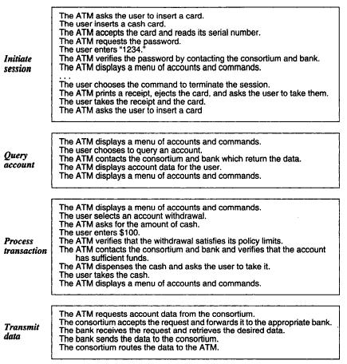

Slide 20
Application Interaction Model
Adding variations and Exception Scenarios
Once normal scenarios prepared, consider “Special” cases, such as omitted input, maximum and minimum values and repeated values.
Then consider “error” cases, including invalid values and failures to respond.
Consider various other kind of interactions also such as help request and status inquiries.

Slide 21
Application Interaction Model
ATM Example:
ATM can’t read the card
Card has expired
ATM times out waiting for a response
Amount is invalid
Machine is out of cash or paper.
Communication lines are down.
Transaction rejected because of suspicious patterns of card usage.

Slide 22
Application Interaction Model
Finding External Events
To find all external events – includes all inputs, decisions, interrupts, and interaction to or from users or external devices.
An Event can execute effects for a target object.
Use scenario to find out normal events, unusual event and error conditions.
In simple words, transmission of information to an object is Event.

Slide 23
Application Interaction Model
For ex. Enter password is message from external User to application object ATM.
Event instances whose values affect the flow of control should be different kinds of events.
Account OK, Bad Account and Bad Password are different events.
Based on event entered, prepared sequence diagram for it.

Slide 24
Application Interaction Model
Prepare a sequence diagram for each scenario.
It shows participation in an interaction and sequences of message among them.
From sequence diagram, you can then summarize the events that each class sends and receives.

Slide 25
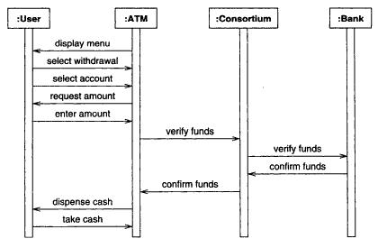
Application Interaction Model
Sequence diagram for the process Transaction Scenario

Slide 26
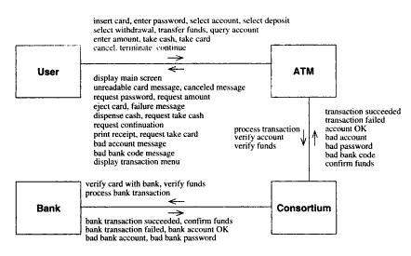
Application Interaction Model

Slide 27
Application Interaction Model
Preparing Activity diagrams for
Complex use Cases
Sequence diagram capture dialog and interplay between actors.
Do not clearly show alternatives and decisions.
Activity diagram let you consolidate all the behavior by documenting forks and merges in the control flow.

Slide 28
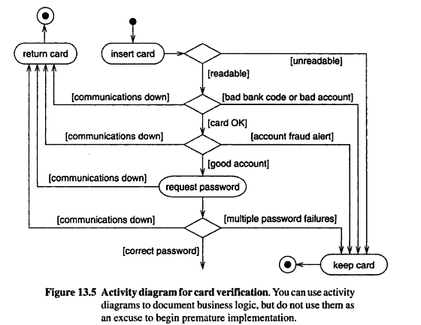

Slide 29
Application Interaction Model
Organizing Actors and Use cases
Next step to organize use cases with relationship (includes, extend and generalization)
It will helpful for large and complex systems.
For. Admin might be an operator with additional privileges.

Slide 30
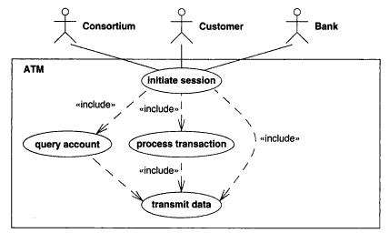
Application Interaction Model

Slide 31
Application Interaction Model
Checking Against the Domain Class model
Application and domain models should be mostly consistent.
The actors, use cases and scenarios are all based on classes and concept from domain model.
Cross check the application and domain models to ensure that there are no inconsistencies.

Slide 32
Application Class Model
Construct an application class model with following steps:
Specify User Interfaces
Define Boundary classes.
Determine controllers.
Check against the interaction model.

Slide 33
Application Class Model
Specifying User Interface
Most interaction divided into two parts
Application Logic
User Interface
A user interface provides the user with way to access its objects, command (function/Features) and application options.
Same program logic can accept input from command lines, files, mouse buttons, touch pane, physical push buttons, or remote links.

Slide 34
Application Class Model
It is acceptable to sketch out a sample interface to help you visualize the operation of an application.
Might need mock up the interface so that user can try it.
Dummy procedure can simulate application logic. It will help you to evaluate the “look and feel” of the user interface.

Slide 35
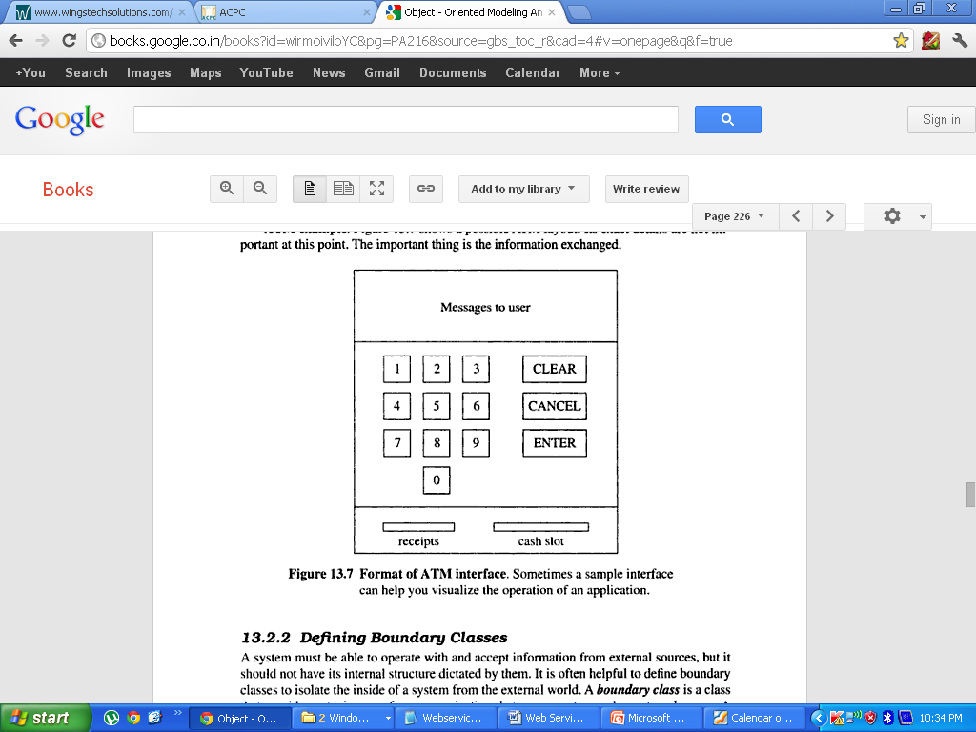
Application Class Model

Slide 36
Application Class Model
Defining Boundary Classes
It is always helpful to define boundary classes to isolate the inside of a system from the external world.
A boundary class is a class that provides a staging area for communication between a system and an external source.
It understand the format of one or more external sources and converts information for transmission to and from the internal system.

Slide 37
Application Class Model
For ex. To summarize the communication between ATM and consortium, we need to define boundary classes (CashCardBoundary, AccountBoundary).

Slide 38
Application Class Model
Determining Controllers
A controller is active object that manages control within the application.
It receives signal from outside world.
Reacts to them
Invokes operation on the objects in the system.
Send signals to outside world.
A controller is piece of reified behavior captured in form of object.

Slide 39
Application Class Model
For Ex. ATM has two major control loops.
Outer loop verifies customer and account.
Inner loop services transactions.

Slide 40
Application Class Model
Checking against the Interaction Model
Once you build class model, go over the use cases and think about how they would work.
For Examples
user sends a command
Parameters of command must come from UI object.
Requesting a command itself must come from some controller.
Finally, simulate use case with the classes.

Slide 41
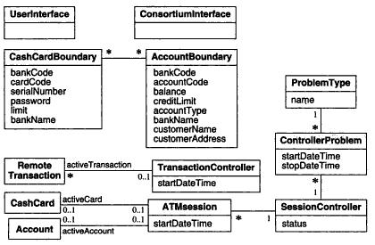
Application Class Model

Slide 42
Overview of Class Design
› In general class design is a process to add details to the class diagrams defined in the analysis phase and making fine decisions
› You choose how to implement your classes considering
› Minimization of execution time, memory and other cost measures
› Choice of algorithms implementing methods
› Breaking complex operation into simpler operations
› OO design is an iterative process
› When one level of abstraction is complete you should design the next lower level of abstraction
› For each level you may
add new operations, attributes, and classes
Revise relations between classes

Slide 43
1.The Essence of Design is…
› To build a bridge across the gap between:
Desired features
Use cases
Application commands
System operations
System services
Available resources
Operating system infrastructure
Class libraries
Previous applications

Slide 44

Creativity
Design is a creative task
You can only be provided with guidelines
The tools you have to fill the gap between resources and features are
Classes
Operations
Other UML constructs
You may have to compromise
The final goal is not to choose the best for single decisions but to optimize the entire system

Slide 45
2.Realizing Use Cases
› Use Cases define the functionalities of a system but not how to realize them
One goal of the design phase is to choose among different possible realizations (finding a balance between advantages and disadvantages)
› Implement the required behavior is not sufficient
You should take into consideration performance, reliability, facilitating possible future enhancements
› Use Cases define system level operations
During design you invent new objects and new operations (at a lower level of abstraction) to provide this behavior
Again: Bridge the gap!

Slide 46
Responsibilities
› First step for realizing a use case is to list its responsibilities
› A responsibility is something that a us case must do to be implemented
› Example: Online theater ticket system
Use case: Making Reservation
Responsibilities:
Finding unoccupied seats for the desired show
Marking the seats as occupied
Obtaining payment from the customer
Arranging delivery of the tickets
Crediting payment to the proper account

Slide 47
4.Designing Algorithms
› Choosing data structures
Data structures do not add information to the analysis model
Data structures organize information to permit efficient algorithms
Data structures include: Arrays, Lists,Trees, Sets, etc.
› Defining internal classes and operations
Expanding high level operation through algorithms may lead to create new (low-level) classes and operations to hold intermediate results

Slide 48
5.Recursing Downward
› Organize operations as layers
Operations in higher layers invoke operations in lower layers
› In general, the design process works top down
Start with the higher-level operations and proceed to define lower-level operations
Functionality Layers
High-level functionalities are decomposed into lesser operations
Implementation of the responsibilities
Mechanism Layers
Support mechanisms to make the system working
□ Store information, coordinate objects, sequence control, transmit information, perform computations, etc.

Slide 49
6.Refactoring
› The initial design always contains inconsistencies, redundancies, inefficiencies
› It is impossible to get a large correct design in one pass
› Refactoring is an essential part of any good engineering process
› It’s not enough to deliver a functionality
If you expect to maintain a design, then you must keep the design clean, modular and understandable

Slide 50
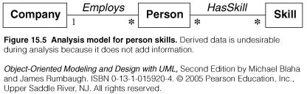
7.Design Optimization:
Provide efficient access paths
› Adjusting the structure of the class model to optimize frequent traversals
› Company.findSkill(speakJapanese)
Frequency of access
Fan out (e.g., 1000 employees with on average 10 skills)
Selectivity (e.g., if only 5 employees actually speak Japanese)

Slide 51
8.Adjustment of Inheritance
Through the following steps:
Rearrange classes and operations to increase inheritance
Abstract common behavior out of groups of classes
Use delegation to share behavior when inheritance is semantically invalid

Slide 52
9.Organizing a Class Design
› Information hiding
Separating external specification from internal implementation
› Coherence of Entities
An entity (a class, an operation or a package) should have a single major theme
A method should do only 1 thing
A class should not serve many purposes at once
› Fine-Tuning Packages
The interface between two packages (the associations that relate classes in one package to classes in the other and operations that access classes across package boundaries) should be minimal and well defined

Slide 53
Chapter 12
Domain Analysis

Slide 54
Topic Covered
Introduction
Overview of Analysis
Domain Class Model
Domain State Model
Domain Interaction Model

Slide 55
Introduction
During analysis, we build models and begin to understand the requirements deeply.
To build a domain model, you must interview business expert, examine requirements statements, and study related requirements.
Successful analysis model states what must be done, without restricting how it is done and avoid implementation decisions.

Slide 56
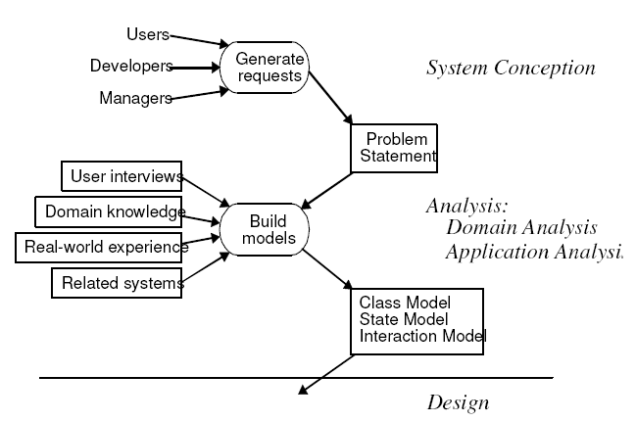
Overview of Analysis

Slide 57
Overview of Analysis
As fig. shows, analysis begin with problem statement during system conception.
Problem statement can be incomplete or informal but analysis makes it more precise and expose ambiguities.
You must understand real-world system described by the problem statement, and abstract its essential features into a model.
Sequence can be problem statement 🡪 build model (Domain) 🡪 build model(application).

Slide 58
Overview of Analysis
Analysis model addresses the three aspects of objects.
Static structure of objects (Class Model)
Interaction among objects ( Interaction Model)
Life-cycle histories of objects (State Model)

Slide 59
Overview of Analysis
First step in analyzing the requirements is to construct a domain model.
Static structure of the real world system is captured.
The domain model describes real-world classes and their relationships to each other.

Slide 60
Domain Class Model
Information for the domain model comes from the
Problem statement,
Artifacts from related systems,
Expert knowledge of the application domain and
General knowledge of the real world.
The steps to be performed to construct a domain class model:
Find Classes.
Prepare a data dictionary.

Slide 61
Domain Class Model
Find associations.
Find attributes of objects and links.
Organize and simplify classes using inheritance.
Verify that access paths exist for likely queries.
Iterate and refine the model.
Reconsider the level of abstraction.
Group classes into packages

Slide 62
Domain Class Model
1. Finding Classes
First Step, find relevant classes for objects from application domain.
It includes houses, person, machines etc.
Classes often correspond to nouns.
Eg- ” a reservation system sell tickets to performances at various theater”-
Tentative classes would be Reservation, System, Tickets, Performance and Theaters.

Slide 63

Domain Class Model
Idea is to capture concepts. not all nouns are concepts, and concepts are also expressed in other parts of speech.
For the Case study of the ATM: The following are the classes extracted from problem statement nouns.

Slide 64
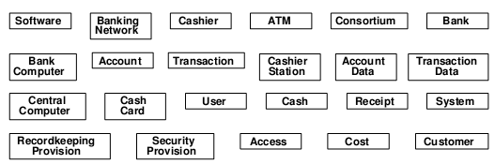
Domain Class Model

Slide 65

Domain Class Model
Additional classes that do not appear directly in the statement but can be identified from our knowledge of the problem domain

Slide 66
Domain Class Model
2.Keeping the Right classes
Discard unnecessary and incorrect classes according to the following criteria.
Redundant classes: If two classes express the same concept, you should keep the most descriptive name.
ATM example. Customer and user are redundant; we retain customer because it is more descriptive.

Slide 67
Domain Class Model
Irrelevant classes: If class has little or nothing do with application, eliminate it.
ATM Ex. cost is outside the scope of the ATM software.
Vague classes: class should be specific.
ATM Example, System, Security provision, Banking network etc are not specific thing.
Attributes: Names that primarily describe individual objects should be restated as attributes.

Slide 68
Domain Class Model
ATM Example, Account Data, Cash, Transaction data are purely indicating attributes not a class.
Operations: If a name describes an operation that is applied to objects and not manipulated in its own right, then it is not a class.
Eg-if we are simply building telephones, then call is part of the state model and not a class

Slide 69
Domain Class Model
But Billings system for telephone calls a Call would be important class with attributes date, time, origin and destination.
Roles: The name of a class should reflect its intrinsic nature and not a role that it plays in an association.
Ex.Owner of a car in a car manufacturing database, not correct as a class. It can be a person( owner, driver, lessee)

Slide 70
Domain Class Model
Implementation Constructs: Eliminate constructs from the analysis model that are irrelevant to the real world.
We may need them during design and not now.
Ex. Transaction Log class.
Derived classes: As a general rule, omit classes that can be derived from other classes.
Mark all derived classes with a preceding slash(‘/’)in the class name.

Slide 71
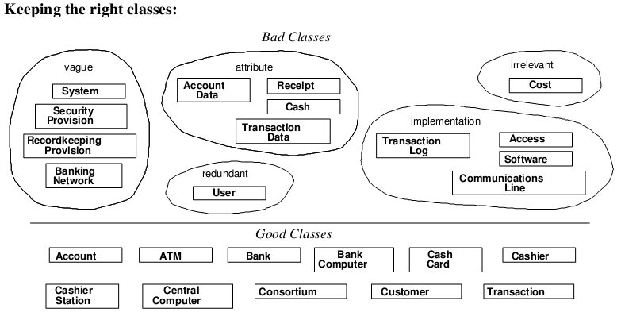

Slide 72
Domain Class Model
3. Preparing a Data Dictionary
Prepare a data dictionary for all modeling elements.
Describe the scope of the class within the current problem, including all assumptions or restrictions on its use.
It also describes associations, attributes, operations and enumeration values.

Slide 73
Domain Class Model
Data Dictionary for the ATM classes
Account,
ATM,
Bank,
BankComputer,
CashCard,
Cashier,
CashierStation
CentralComputer,
Consortium,
Customer,
Transaction

Slide 74
Domain Class Model
4. Finding Associations
Find A structural relationship between two or more classes is an association.
A reference from one class to another is an association.
Associations often correspond to verbs or verb phrases.
Ex. Physical Location ( part of, NextTo)
Directed Actions (Drives)
Communication (Talks To)

Slide 75
Domain Class Model
Ownership ( Has, Part of)
Satisfaction of condition ( WorksFor, Manages).
Idea here is to capture relationships

Slide 76
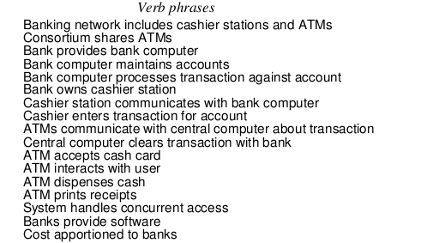
Domain Class Model

Slide 77
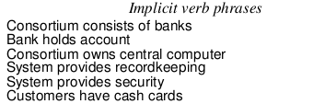

Domain Class Model

Slide 78
Domain Class Model
5. Keeping the Right Associations
Discard unnecessary and incorrect associations, using the following criteria:
Associations between eliminated classes: If you have eliminated one of classes then either you eliminate association or restate it.
Ex. Banking Network includes cashier stations and ATMs.
ATM dispenses cash

Slide 79
Domain Class Model
ATM prints receipts
Bank provide software
Cost apportioned to banks
System provides record keeping and
System provides security.
Irrelevant or implementation associations: Eliminate any association that deals with implementation or outer problem statement.
Ex. System handles concurrent access (Implementation)

Slide 80
Domain Class Model
Actions: An association should describe a structural property of the application domain not a transient event.
Ex. ATM accepts Cash card (Interaction cycle)
It is not a permanent relationship between ATM and Cash.
Eliminate ATM interact with user. Central computer clears transactions with bank .

Slide 81
Domain Class Model
Ternary associations: You can decompose most association among three or more classes into binary associations.
Always decomposed without losing information.
Ex. Bank computer processes transaction against account can be convert into Bank computer processes transaction and transaction concern accounts.

Slide 82
Domain Class Model
Derived associations : Omit association and attributes, they may be redundant.
Ex. GrandParentOf can be defined in terms of pair of ParentOf.
Ex. youngerThan expresses condition on the birthdate of two person, not additional information.
Derived association don’t add information, they useful for understanding.

Slide 83
Domain Class Model
Semantics of Association
Misnamed Association: Name are important to understanding and should be chosen with care.
Ex. Bank computer maintain accounts. Rephrase as Bank hold account.
Association End name: Add association end name where appropriate.
Ex. Person manages person. It would be appropriate to give end names boss and worker

Slide 84
Domain Class Model
Qualified Associations: Most names are not globally unique. So context combines with the name to uniquely identify the object.
Ex. Company name unique within one state but may be duplicated in other state.
So combining State + Company name will uniquely identify company.
Ex. bankCode differentiate bank in a consortium.

Slide 85
Domain Class Model
Multiplicity: Don’t put much effort as it is often changes during analysis.
Missing Association: Add any missing association that are found during analysis.
Transaction entered on cashier station, Customers have accounts and transaction authorized by cash cards.
To perform above, we need to introduce relationship from Cashier to cashier station. So association Cashier authorized on cashier station needed

Slide 86
Domain Class Model
Aggregation: it is specially for mechanical parts or bills of material.
Don’t spend much time trying to defer between association and aggregation.
Ex. Bank is part of Consortium and indicate the relationship with aggregation.
Now combining all things together, class diagram prepare.

Slide 87
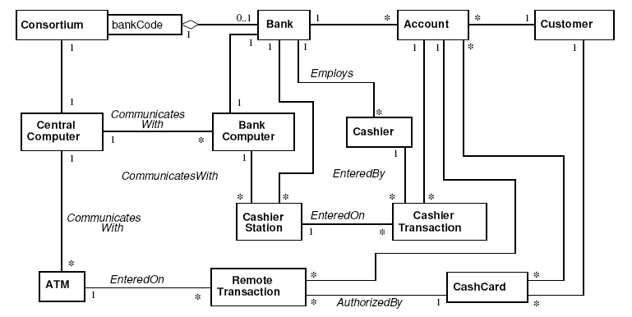
Domain Class Model

Slide 88
Domain Class Model
6. Finding Attributes:
Attributes are data properties of objects like colour, weight etc.
Attributes usually correspond to nouns followed by possessive phrases, such as “the color of the car”
Attributes are less likely to be fully described in problem statement.
Only consider attributes directly relevant to application. Get important attributes then add details to it.

Slide 89
Domain Class Model
Avoid derived attributes.
EX. Age is derived from birthdate and currentTime
Looks for attributes on associations.
Ex. Workfor association attribute can be salary, title etc.

Slide 90
Domain Class Model
7. Keeping the Right Attributes
Eliminate unnecessary and incorrect attributed with the following criteria:
Objects: if element is important rather than just its value, then it is an object.
Ex. Boss refers to a class and Salary is an attributes.
Name: Name often refer as Qualifier rather than attributes.
Name is an attribute when its use does not depend on context,

Slide 91
Domain Class Model
Ex. Names of person are not unique therefore its attributes.
Identifiers: it mean referencing objects used for some work.
Ex. ATM transaction always generate Transaction ID for each operation. So you can count Transaction ID as attributes.
Attributes on Association:
If value require the presence of link then attributes of the association should derived.

Slide 92
Domain Class Model
Ex. Workfor association attribute can be salary, title etc
Internal Values: if an attributes describes internal state of an object then eliminate it.
Fine Detail: Omit minor attributes that are unlikely to affect most operation.
Discordant attributes :- an attribute that seems completely different from and unrelated to all other attributes then remove it.

Slide 93
Domain Class Model
Boolean Attributes: Convert Boolean attributes into enumeration.

Slide 94
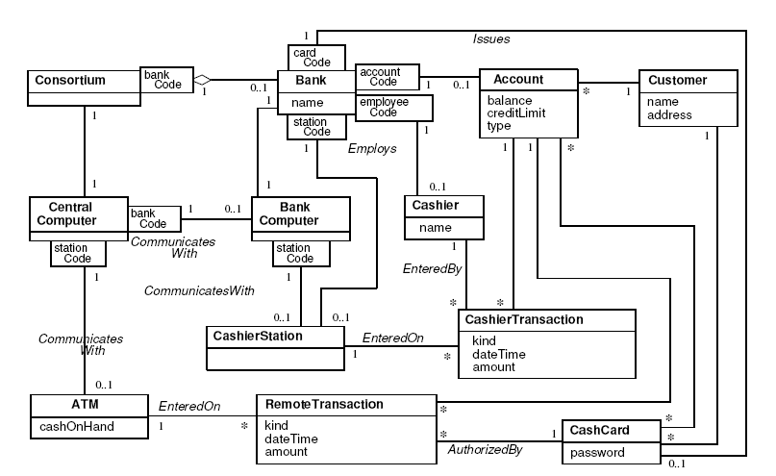
Domain Class Model

Slide 95
Domain Class Model
8. Refining with Inheritance
Next step, to share common structure.
Apply in two directions:
Bottom Up
By Generalizing common aspects of existing classes into a superclass.
Top Down
By Specializing existing classes into multiple classes

Slide 96
Domain Class Model
Bottom Up Generalization:
Searching for classes(from bottom up) with similar attributes, associations and operation.
For each generalization, define a superclass to share common features.
May have to slightly redefine some attributes or classes to fit in. But don’t push too hard it create wrong generalization.
Ex. RemoteTransactiona and CashierTransaction are similar and can be generalized by Transaction.

Slide 97
Domain Class Model
Top-Down Specialization:
It main derived from application domain itself.
Look for noun phrases composed of adjectives:
Fixed menu, sliding menu and text menu.
Avoid excessive refinement.

Slide 98
Domain Class Model
Generalization Vs. enumeration :-
Generalization is all about common structure
Enumeration is all about list of values.
Ex. CurrentAccount and SavingAccount share common structure but it does not affect behavior within the ATM application. So Type can introduces as attributes of account and enumerate it.
Multiple Inheritance: if require then apply because it increasing both conceptual and implementation complexity

Slide 99
Domain Class Model
Similar association:
when the same association name appears more than once with the same meaning, try to generalize the associated class.
Ex. EntryStation generalizes CashierStation and ATM.
Adjusting inheritance Level
Assign attributes and association to specific classes in the class hierarchy.
You may need some adjustment to get everything right.

Slide 100
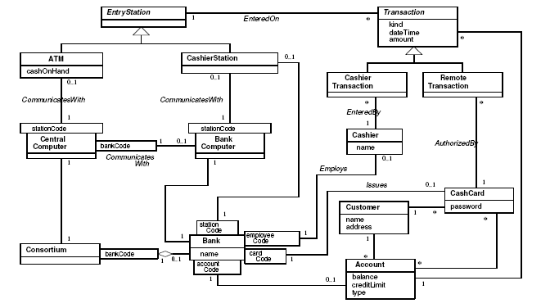

Slide 101
Domain Class Model
9.Testing Access Paths
Verify that access paths exist for likely queries.
Trace access paths through the class model to see if they yield sensible results.
Make sure you have not overlooked any associations.

Slide 102
Domain Class Model
10. Iterating a Class model
A class model is rarely correct after a single pass.
If you find any deficiency, go back to an earlier stage if necessary to correct it. So iterate and refine the model.
There are some sing of missing classes.
Asymmetries in association and generalization.
Disparate attributes and operation on a class.
Difficulty in generalizing cleanly.

Slide 103
Domain Class Model
Duplicate association with same name and purpose.
A role that substantially shapes the semantics of a class. Ex. It mean converting association into a class.
Look out for missing associations
Missing access paths for operations
Lack of attributes, operations and association on a class.
Redundant information:
Adjust the placement of attributes and associations

Slide 104
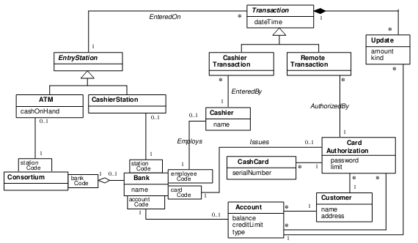

Slide 105
Domain Class Model
11.Shifting the level of abstraction
Abstraction makes a model more complex but can increase flexibility and reduce the number of classes.
In case of abstraction, we need to think in terms of pattern.
A pattern distills the knowledge of experts and provide a proven solutions to a general problem.
Ex. Management hierarchy.

Slide 106
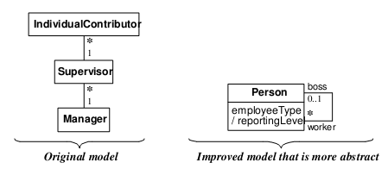
Domain Class Model

Slide 107
Domain Class Model
12.Group classes into packages.
The last step of class modeling is to group classes into packages.
A package is a group of elements(classes, association, generalizations and lesser packages) with common theme.
When you place classes and association in a package, you are making semantic statement.

Slide 108
Domain Class Model
Therefore, package might be:
Tellers – Cashier, Entry Station, Cashier Station, ATM
Accounts – Account, cash card, card authorization, customer, transactions, update, cashier transaction, remote transaction.
Bank- consortium, bank
Each package can add details to it.

Slide 109
Domain State Model
The Following steps are performed in constructing a domain state model
Identifying classes with states
Finding states
Finding Events
Building state diagrams
Evaluating state diagrams

Slide 110
Domain State Model
1. Identifying Classes with states
Study list of domain classes.
Look for classes that can be characterized by a progressive history or represent cyclic behavior.
Identify significant states in the life cycle of an Object. Not every state occurs in every cycle.
ATM Example, Account is appropriate behavior for ATM. Life cycle of Account is progressive and cycling to and from problem states.

Slide 111
Domain State Model
Finding States
List the state for each class.
Characterized the object by their
Attributes Values
Associations that may participants
Attributes and association that are meaningful in certain states only.
Avoid names that indicate how the state came.

Slide 112
Domain State Model
By looking at events and considering transitions among states, missing states will become clear.
Ex. Some states for Account
Normal (Normal access)
Closed ( Closed by customer)
Overdrawn ( withdrawal exceeds the balance)
Suspended ( blocked for some reason)

Slide 113
Domain State Model
Finding Events
Now find events that cause transitions among states.
Think about stimuli (input) that cause a state to change.
Find other events that takes object into a specific states
Ex. Pickup receiver on telephone, it enters into Dialing State.
But many telephone has pushbuttons that invoke specific functions.

Slide 114
Domain State Model
So there are some additional event that occur within a state and don’t cause a transitions.
For Domain State model, make focus on events that cause transition among states.
Ex. Event includes: close account, withdraw excess funds, repeated incorrect PIN, suspected fraud and Administrative action.

Slide 115
Domain State Model
Building State diagrams
Determine for which state, each event applies.
Add transitions to show the change in state caused by the occurrence of an event when an object is in particular state.
Once you have specified the transitions, check does it represent an error or not? If yes then add transitions to error state.

Slide 116
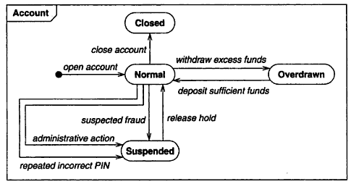
Domain State Model

Slide 117
Domain State Model
Evaluating State Diagram
Examine each state model. Are all states connected?
Path from initial state to the final state?
Are the expected variations represent it?
Are there any dead states that terminate the cycle?
Find missing path and states from it.
When complete, it should indicate life cycle of the class.

Slide 118
Characteristics of Objects - Classification
Each objects is said to be instance of its class.
Objects has its own value for each attributes but shares the attributes names & operations.
Example : Class Name : Circle
Attributes : radius, center
Operation : setCenter(), setRadius()

Slide 119
Characteristics of Objects - Inheritance
Definition: Sharing of attributes & operations (features) among classes based on hierarchical relationship.
A superclass has general information that subclass refine and elaborate.
Each subclass incorporates all the features of its superclass and adds its own features.
In other words, defining new classes from the existing one.

Slide 120
Characteristics of Objects - Inheritance
Note: subclasses need not repeat the features of the superclass.
Advantage: common features of several classes into a superclass can reduce repetition within design and programs.

Slide 121
Characteristics of Objects – Example of Inheritance
Inheritance is implied by is-a or kind-of relationship.
class Person {
String name;
String age;
void birthday () {
age = age + 1;
}
}
class Employee
extends Person {
double salary;
void pay () { ...}
}
Person
Every Employee has a name, age, and birthday method as well as a salary and a pay method.
Employee

Slide 122
Characteristics of Objects – Polymorphism
Definition
Same operation may behave differently for different classes.
In simple words, “ One name multiple form”
Here operation mean – it’s a procedure or transformation that an object perform or is subject to.
For example , Class name is POLYGON
Attributes - vertices, border color, fill color.
Operations – Draw, erase, fill
An implementation of an operation by a specific class is called Method

Slide 123
What is OO Development?
OO Development refers to the software life cycle.
i.e. Planning, Analysis, Design & Implementation
Why OO Development?
In essence of OO development is the identification & organization of application concepts, rather than in a programming language.

Slide 124
OO Dev – Modeling Concept, Not implementation
Earlier, OO community focused on implementation part rather than analysis and design.
It focuses excessively on implementation mechanisms rather than the underlying thought process that support.
An OO development approach encourage software developers to work & thinks in terms of the application throughout software life cycle.

Slide 125
OO Dev – Modeling Concept, Not implementation
OO development is a conceptual process independent of a programming language until the final stage.
OO development is fundamentally a way of thinking & not a programming technique.
It can serve as a medium for specification, analysis, documentation & interfacing as well as for programming

Slide 126
OO Dev – Modeling Concept, Not implementation
OO Development & Graphical notation represents OO concept.
OO process consists of building a model of an application & then adding details to it during design.
Same notation is used from
Analysis 🡪 Design 🡪 Implementation.
So information is not lost or translated into the next stage [Reusability].

Slide 127
OO Development Stages
System Conception
Analysis
System Design
Class Design
Implementation

Slide 128
System Conception
System Conception means origin of the system.
S/W development begins with
- business analyst or users conceiving an application & formulating tentative requirement.

Slide 129
OO Development Stages
System Conception
Analysis
System Design
Class Design
Implementation

Slide 130
Analysis
Task of Analyst
Must work with the requester (client) to understand the problem, because problem statement are rarely complete or correct.
To design the Analysis model which demonstrates what the desired system must do, not how it will be done.
Analyst is not concerned about implementation decision.

Slide 131
Analysis
Analysis model
Domain model
Application model
Description of
real-world
objects reflected
Within the system
Description of the
parts of application
system itself that are
visible to the user.
Ex. Bank account is domain model.
Application model includes Saving accounts, current account, demat account etc.

Slide 132
OO Development Stages
System Conception
Analysis
System Design
Class Design
Implementation
‹#›

Slide 133
System Design
Task of system designer
- must decide what performance characteristics to optimize.
- choose strategy to attack the problem.
- making tentative resource allocation.
Ex. Designer might decide to change the window screen for fast & smooth working, even when windows are moved or erased.

Slide 134
OO Development Stages
System Conception
Analysis
System Design
Class Design
Implementation
‹#›

Slide 135
Class Design
Task of class designer
- add details to analysis model
- They determine data structures & algorithm for each of the operation of window class.
- They elaborate both domain & application
objects using same OO concept & notation.

Slide 136
OO Development Stages
System Conception
Analysis
System Design
Class Design
Implementation
‹#›

Slide 137
Implementation
Task of Implementers :-
Translates the classes & relationships developed during class design into particular programming language, database or hardware
During implementation, follow good software engineering practice so that traceability to the design is apparent (i.e. clear).

Slide 138
Summary of OO Development
OO concepts apply throughout the System Development Life Cycle (SDLC)
i.e. Analysis 🡪 design 🡪 implementation
Use same classes from stage to stage without a change of notation.
Some classes are not part of analysis but are introduced during design or implementation.
Ex. Data structure such trees, hash table & linked list are not visible to users at the time of analysis.
but designers introduce them to support particular algorithms.

Slide 139
Three Software Models
Models
Class Model
State model
Interaction model
Objects in the system and their relationship
Life history of objects in the system
Interaction among objects

Slide 140
Class model
Describe the static structure of the objects in a system & their relationship
It define the context for software development.
Class model contains class diagram to express it.
A class diagram is graph phase.
Nodes are classes.
Arcs are relationship among classes.
Book
classes
Store
Relationship

Slide 141
State Model
Describe aspect of an object that change over time.
State model specifies & implement control with state diagram
A state diagram is a graph whose
Nodes are state
Arcs are transitions between state caused by events
State Diagram
Event
State 1
State 2

Slide 142
Interaction model
How the objects in a system co-operate to achieve broader results.
Interaction model start with
Use case that are elaborate into with sequence and activity diagram.
Sequence Diagram
Elaborate
Use Cases
Activity Diagram

Slide 143
Interaction Model
Use cases:
Focus on functioning of system
Simple mean, what a system does for users
Sequence diagram
Shows the object that interact
Time sequence of their interactions
Activity diagram
Elaborate important processing steps.
Activity diagrams can be used to describe the business and operational step-by-step workflows of components in a system

Slide 144
OO Modeling History
Grady Booch
James Rumbaugh
Ivar Jacobson
Are the man behind Invention of OO Modeling Technique.
Object Modeling Technique (OMT) concept evolved in 1991.

Slide 145
OO modeling History
In 1994 James Rumbaugh joined Rational (now the part of IBM) in 1994 & began working with Grady Booch on UML Notations.
In 1995, Ivar Jacobson also joined Rational & added his concept to the unification work.

Slide 146
OO modeling History
In 1996 the Object Management Group issued a request for proposals for standard OO modeling notation.
Later Rational led the final proposal team, with Booch, Rumbaugh & Jacobson deeply involved.

Slide 147
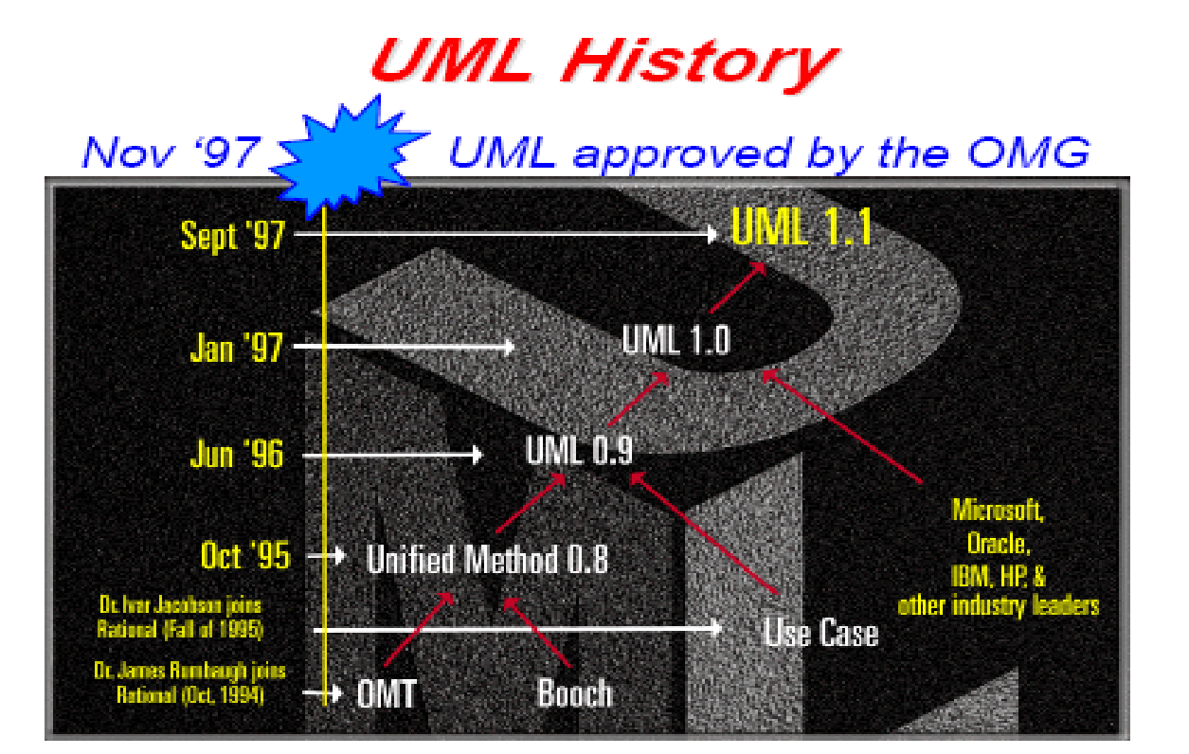
OO modeling History

Slide 148
OO THEME
OO themes are not unique to OO systems, they are particularly well supported.
Abstraction
Encapsulation
Combining data and behavior
Sharing
Emphasis on the essence of an object
Synergy

Slide 149
OO THEME
Abstraction:
Focus on essential aspects of an application while ignoring details.
i.e. focusing on what an object is and does, before deciding how to implement it.
Use of Abstraction:
Freedom to make decisions as long as possible by avoiding premature commitment to details.
Ability to abstract is probably the most important skill required for OO development.

Slide 150
OO THEME
Encapsulations ( Information Hiding):
It is separates the external ( accessible to objects) aspects of an objects from the internal ( hidden from other objects) implementation details.
It prevents portions of a program from becoming so interdependent that a small change has massive ripple effects.
For ex. You may want to change the objects to
Improve performance, Fix a bug, Consolidate code, Support porting

Slide 151
OO THEME
Encapsulation is not unique to OO language but ability to combine data structure & behavior in a single entity makes encapsulation cleaner & powerful.

Slide 152
OO THEME
Combining data & Behavior
In non-OO code, to display the content of a window must distinguish the type of each figure, such as circle, polygon etc & call the appropriate procedure to display it.
In OO code, program invoke the “Draw” operations on each figure and each object implicitly decide which procedure to use, based on its class.
So caller of an operation need not consider how many implementation exist.

Slide 153
OO THEME
So, maintenance is easier, because the calling code need not be modified when a new class is added.
In an OO system, the data structure hierarchy matches the operation inheritance hierarchy.
Data structure Hierarchy
Is replaced by
Class Hierarchy
Procedure Hierarchy

Slide 154
OO THEME
Sharing
OO technique promote sharing at different levels.
Sharing via inheritance is one of the main advantage of OO language.
OO development not only lets you share information within an application, but also offers the aspects of reusing designs & code on future projects.
OO provides the tools to build libraries ( or collection) of reusable component.

Slide 155
OO THEME
Emphasis on the essence of an object:
In OO technology, focus is on what an objects is rather than how it is used.
Use of an object depend on the details of application and often change during development.
OO development greater emphasis on data structure & lesser emphasis on procedure structure.

Slide 156
OO THEME
Synergy :
OO concepts can be used in isolation but together they complement each other synergistically.

